Slide 1


Maharaja Institute of Technology Thandavapura
DBMS MINI PROJECT – 18CSL58
ON
E-COMMERCE DATABASE MANAGEMENT SYSTEM
SUBMITTED BY :
R VIDYA - 4MN19IS028
ROSHAN K -4MN19IS045
SPOORTHI R -4MN18IS010
UNDER THE GUIDENCE OF
PROF.MOHAMMAD SALAMATH
DEPT OF ISE

Slide 2
INTRODUCTION
Electronic Commerce is process of doing business through computer networks. A person sitting on his chair in front of a computer can access all the facilities of the Internet to buy or sell the products. Unlike traditional commerce that is carried out physically with effort of a person to go & get products, ecommerce has made it easier for human to reduce physical work and to save time. E-Commerce which was started in early 1990’s has taken a great leap in the world of computers, but the fact that has hindered the growth of e-commerce is security. Security is the challenge facing e-commerce today & there is still a lot of advancement made in the field of security. As e-commerce is one of the top growing businesses in India and provides a great market potential for investments, foreign Investors are funding e-commerce sector. The study concludes that there would be a prospective growth of e-commerce in India, if the Government provide a legal security and framework for e-commerce and the domestic and international trade are allowed to expand their basic rights such as intellectual property, privacy, prevention of fraud, consumer protection, etc.

Slide 3




Registration
In order to use the Systems the users will need to register in the system, and for registration, they need to provide various information related to them such as name, address, etc.
Cart
After selecting a product if the user wants to purchase it, later they can save the product in the cart.
Check out
Through this module, the user can place their order and can choose preferred method for payment.
Purchase history
This will show the purchase done by the user in the past.

Slide 4
Existing System
The E-commerce Management System has various flaws in it as because of which most of the people don’t use the system even though it has several advantages over traditional stores. The biggest problem is that it takes at least a day to deliver a product to the customer. While some other issues are a duplication of the product means the product is shown on the web some time differs with the original product due to which next time that customer go to buy the product through the traditional type of store.

Slide 5
Proposed System
The E-commerce Management System has many advantages, compare to traditional store as one can compare the cost of a product with other e-commerce websites, and if a user dislikes any product, he/she can return it. While we can make use of the current technology to overcome the problem with the existing system. The E-commerce Management System companies can use a flying robot, so when a user places an order, the company will send the product through the robot. The robot will find the user by using the GPS, and in this way, we can reduce the time to deliver a product. While before sending a product the e-commerce company will check the product that it is same or not with the requested order.
1. Wide Range of Products.
2. Easy To Use.
3. User Friendly.
4. Secure Transaction.

Slide 6
Software requirements
1. Operating system
Windows 7/8/10/11
2. Frontend: HTML 5 and CSS 3
3. PHP
4. Backend: MYSQL

Slide 7
Hardware requirement
RAM: 2GB
Hard Disk: 500GB
Processor: 2.2 GHz 64 bit
Other devices: Mouse and Keyboard

Slide 8
Software Requirements
Operating system : Linux/Windows.
Front End :HTML ,CSS , Javascript , Php.
Backend : MySQL

Slide 9
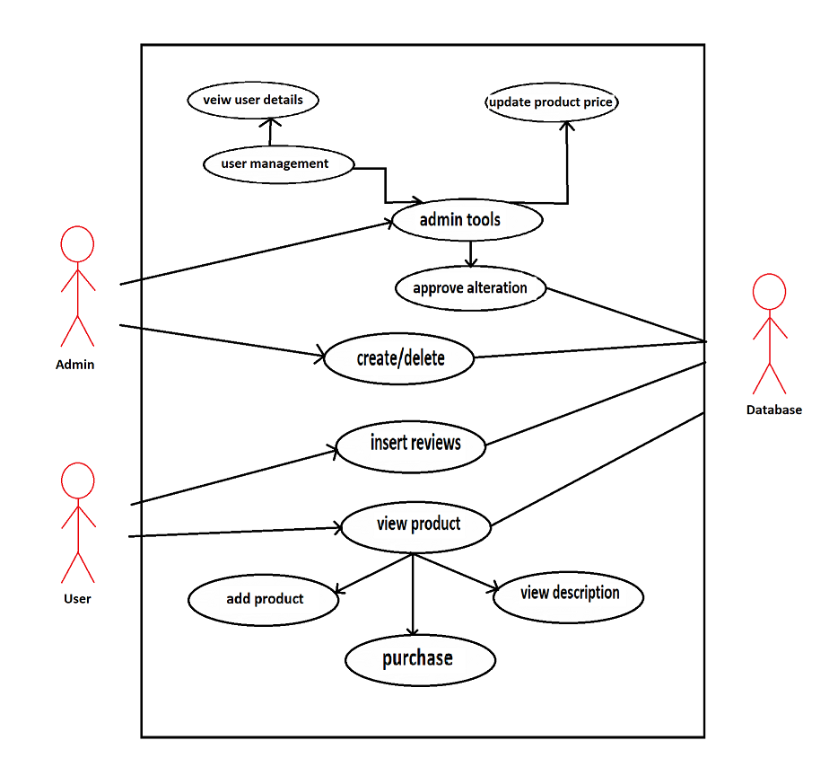
Use case diagram

Slide 10
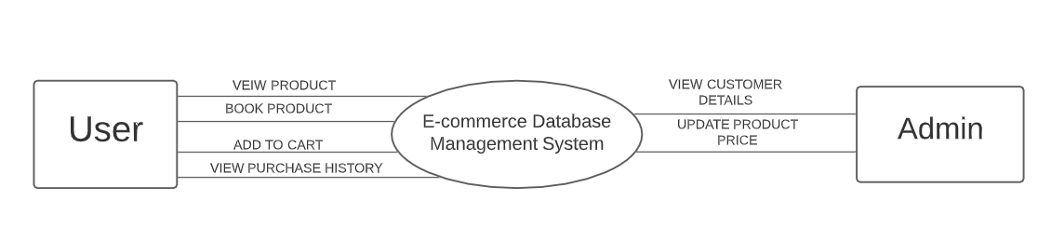
Data flow Diagram

Slide 11
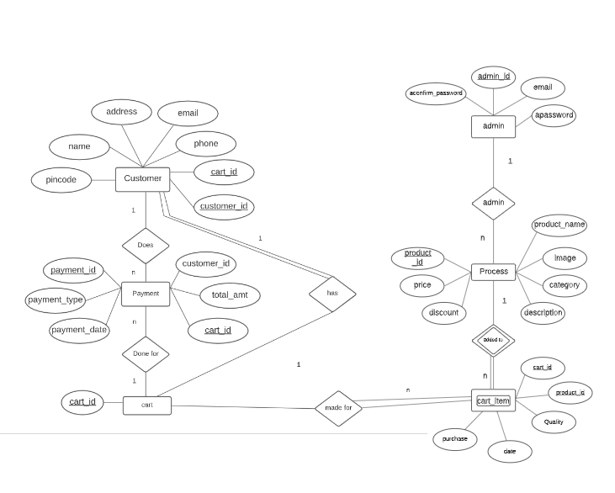
Entity Relation Diagram

Slide 12
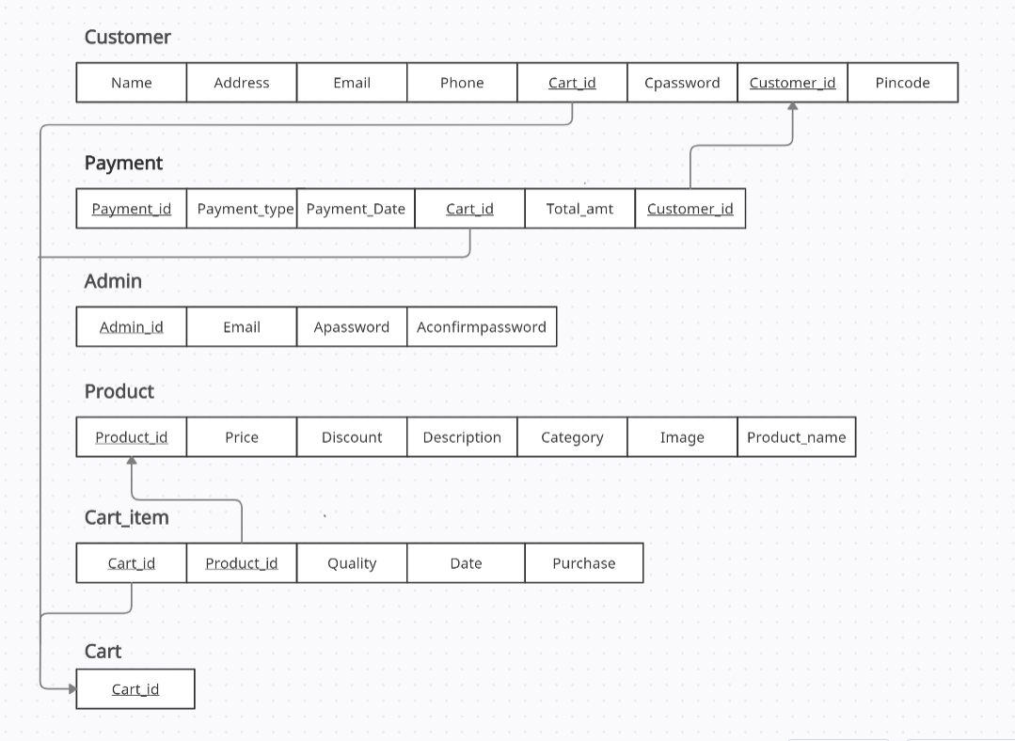
ER mapping to physical schema-diagram

Slide 13

Implementation and Results
Implementation of a DBMS project means carrying out the execution of any idea or model. It refers to the process of setting a new software or hardware for doing the specific task. In our mini project we have used Bootstrap 4 and MySQL for front-end and back-end respectively and Php is used to connect both front-end and back-end.

Slide 14
Conclusion
Presently we designed the E-drive project to be as userfriendly as possible. The main mottobehind our intentions is to save the timeof the candidate as well as the person in-charge of the placements in the respected college.
We have given a chance to students to rate their own skills so as to showcase their capabilities far more than just academics. Since there is a feature of double tier tests, there are more chances that the candidates chosen truly belongs to what they deserve.

Slide 15
References
[1] www.google.com
[2] www.github.com
[3] www.quora.com
[4] www.w3school.com
[5] www.youtube.com
[6] Learn to code HTML and CSS by Shay Howe.
[7]Book: Head first html by Kathy Sierra and Bert Bates, Information practices by Sumita Arora.

Slide 16
Thank you

